Slide 1
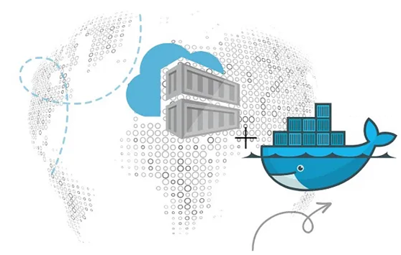
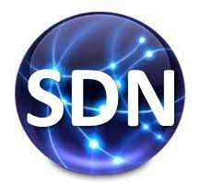
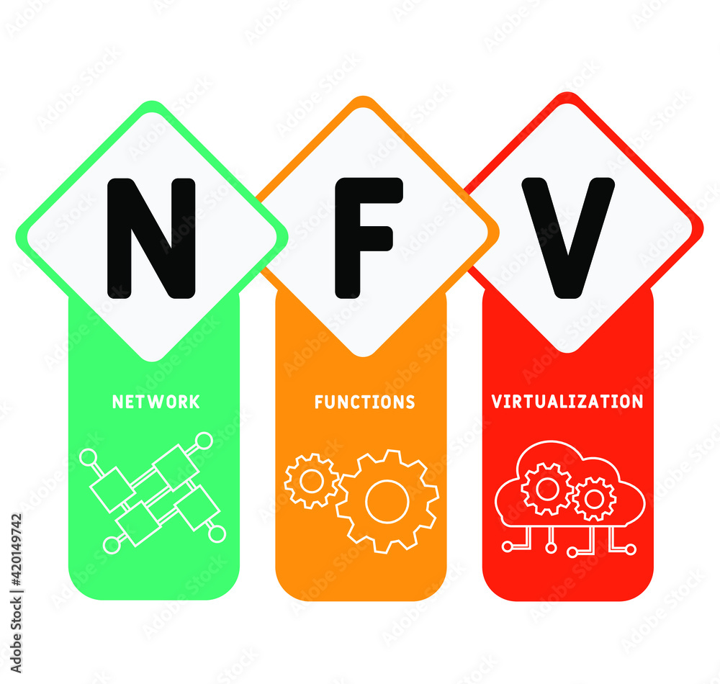
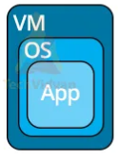
PDS
Computer Vision
Kubernetes_Minikube Provider and Open Tofu
https://github.com/siagianp
https://www.youtube.com/@AmelOline/videos
Open TofU-IaC
https://github.com/amelcharolinesgn2/IoT_simulator-mqtt-NodeRed
https://github.com/amelcharolinesgn2/Cloud-Infrastructures
Notes:
https://roadmap.sh/aws
https://roadmap.sh/aws
https://aws.amazon.com/what-is-cloud-computing/
https://www.ibm.com/think/topics/cloud-computing
3. https://www.ibm.com/topics/cloud-computing
4. https://csrc.nist.gov/pubs/sp/800/145/final
https://csrc.nist.gov/pubs/sp/800/145/final
https://docs.openstack.org/liberty/install-guide-rdo/overview.html

Slide 2
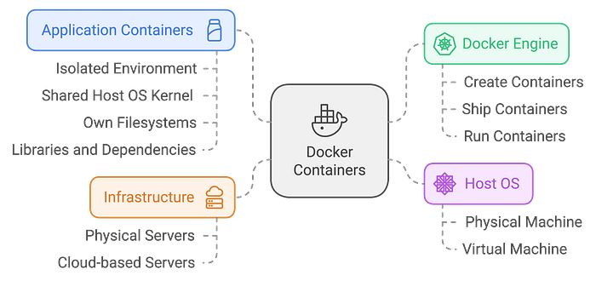
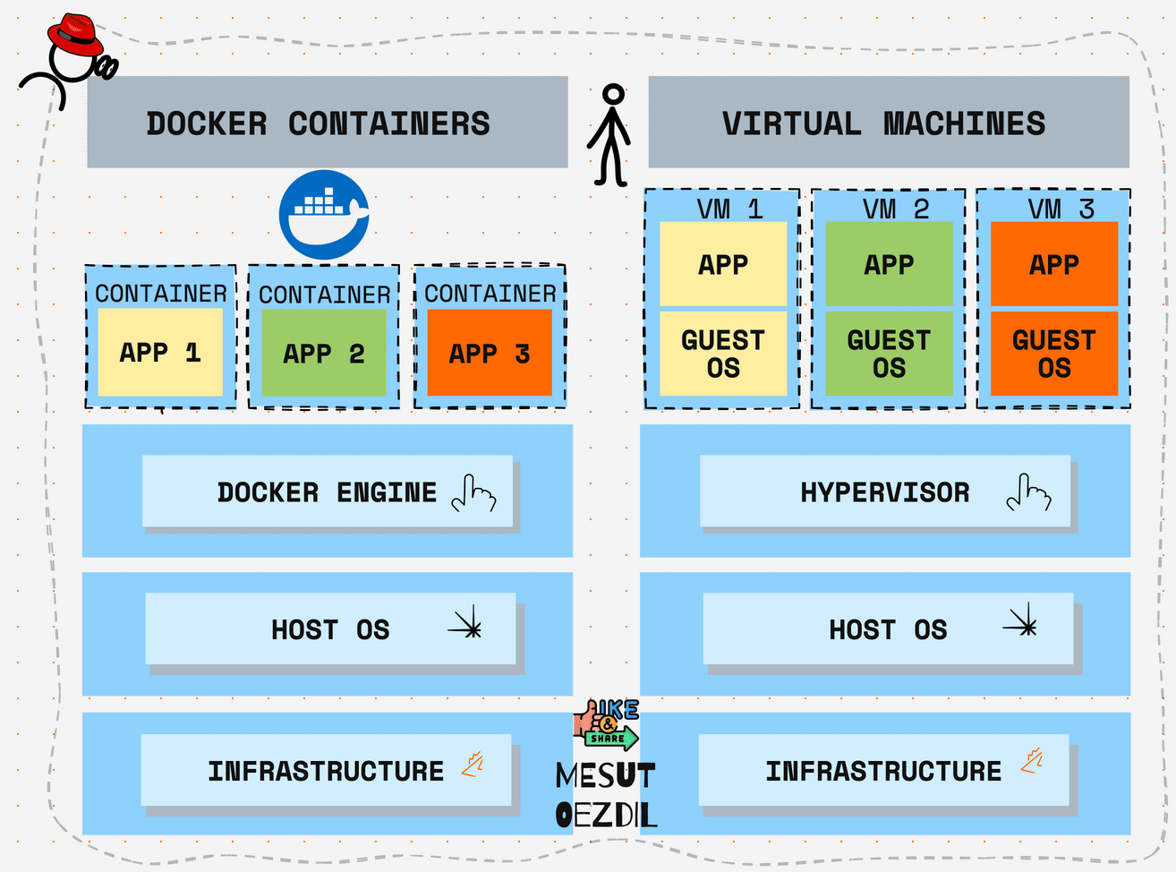
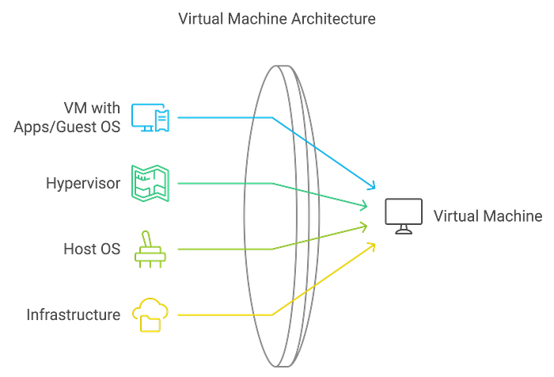
Review : Docker vs VM
Notes:
https://mesutoezdil.medium.com/docker-containers-and-virtual-machines-explained-3f8a9bbf5a3b

Slide 3
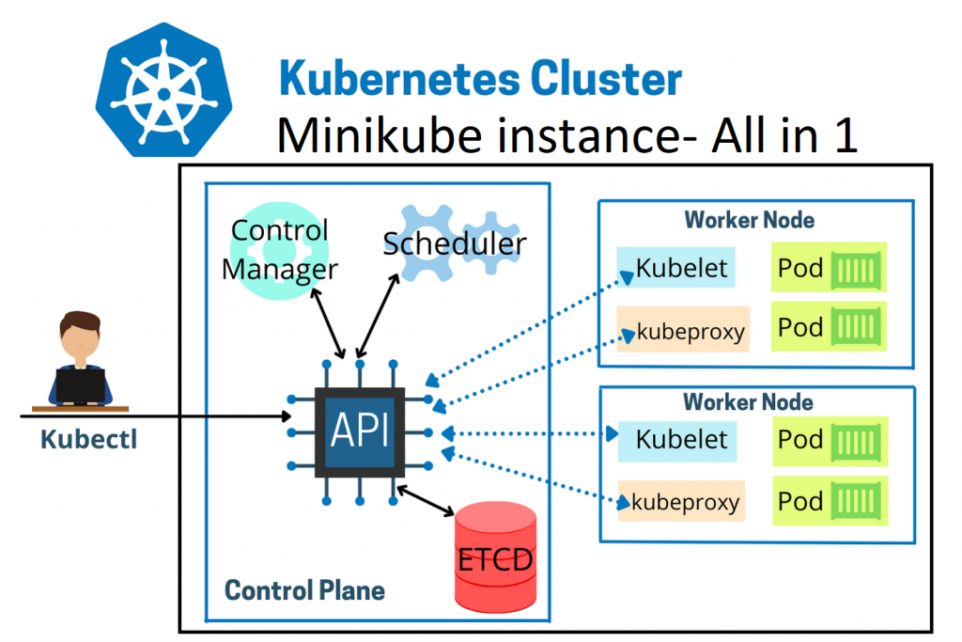
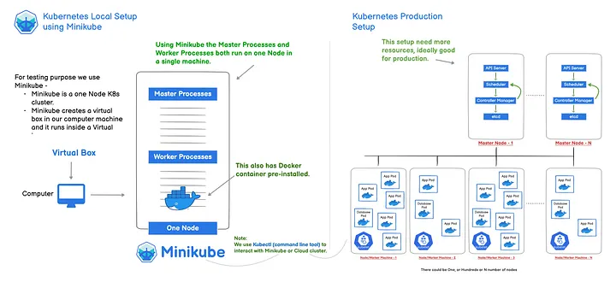
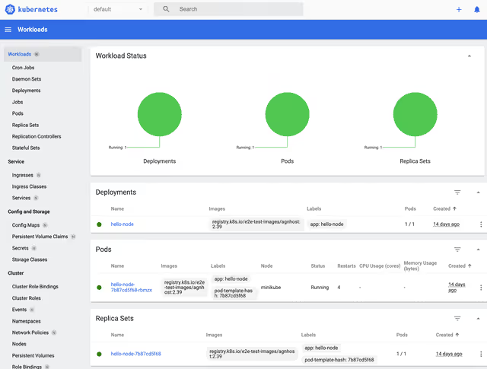
Kubernetes
Notes:
https://aws.plainenglish.io/kubernetes-local-setup-using-minikube-and-kubectl-3-a46b7effe693
https://www.signadot.com/blog/beginner-minikube-guide

Slide 4
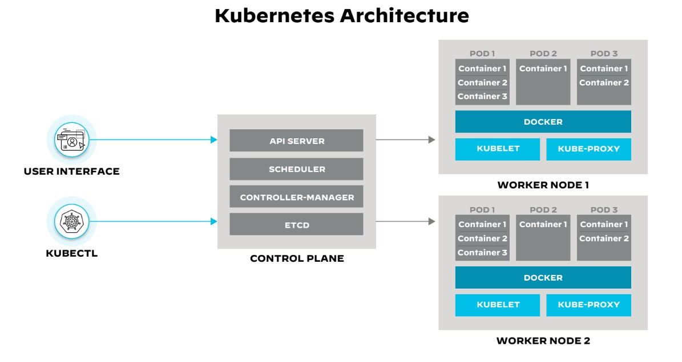
Kubernetes Architecture
Notes:
https://www.paloaltonetworks.com/cyberpedia/what-is-kubernetes

Slide 5
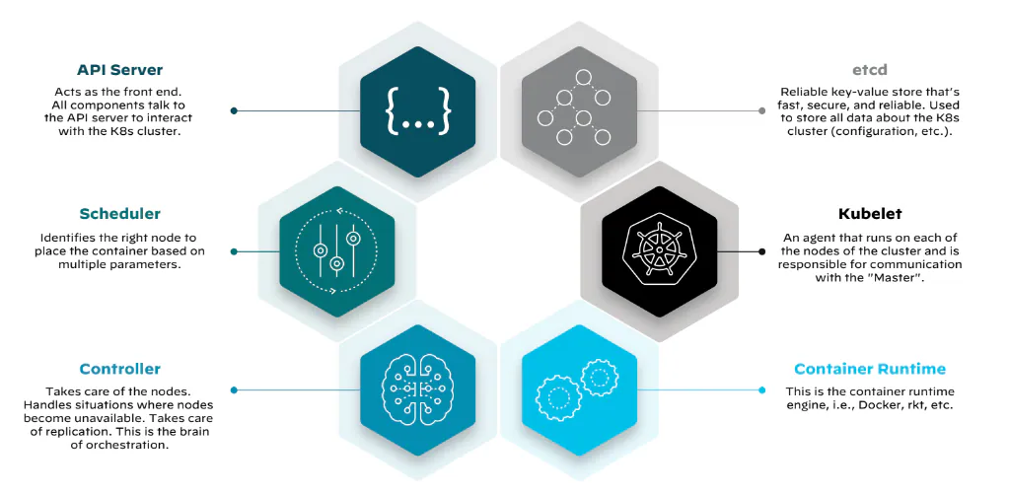

Slide 6
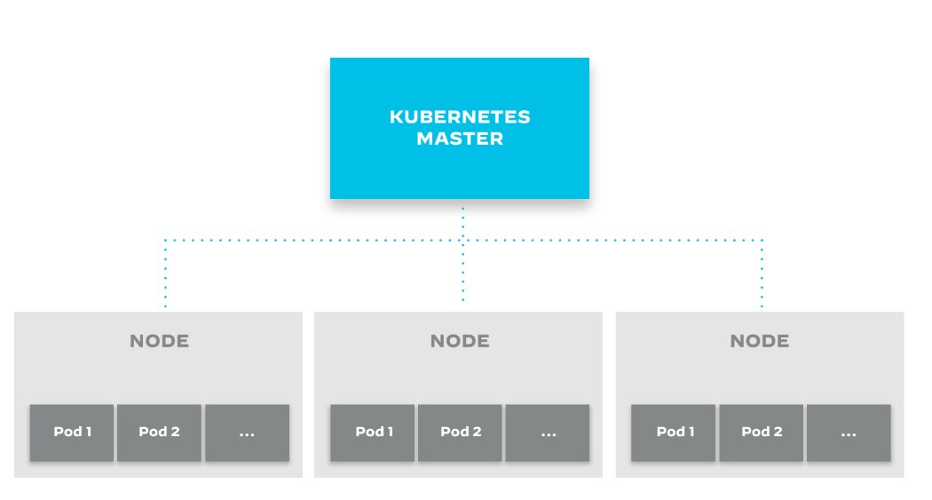
Notes:
https://www.paloaltonetworks.com/cyberpedia/what-is-kubernetes

Slide 7
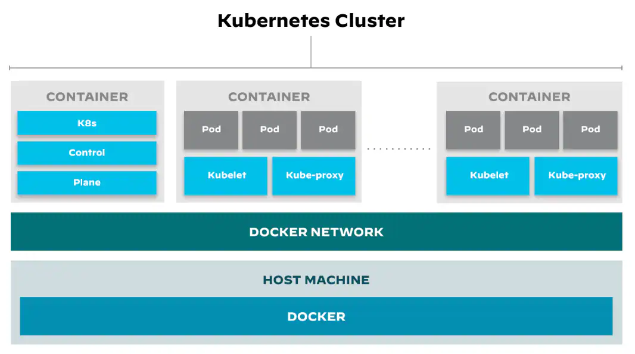
Notes:
https://www.paloaltonetworks.com/cyberpedia/what-is-kubernetes

Slide 8
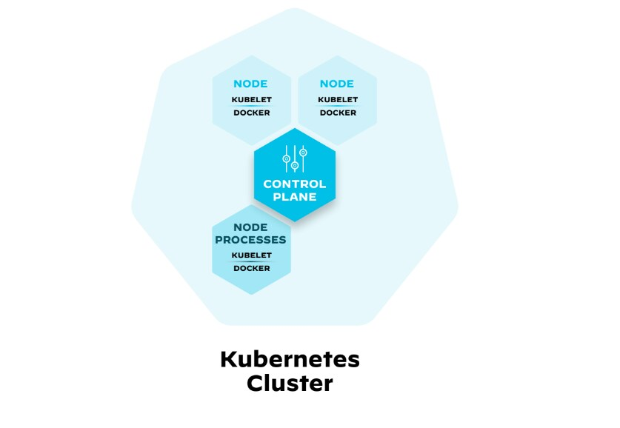
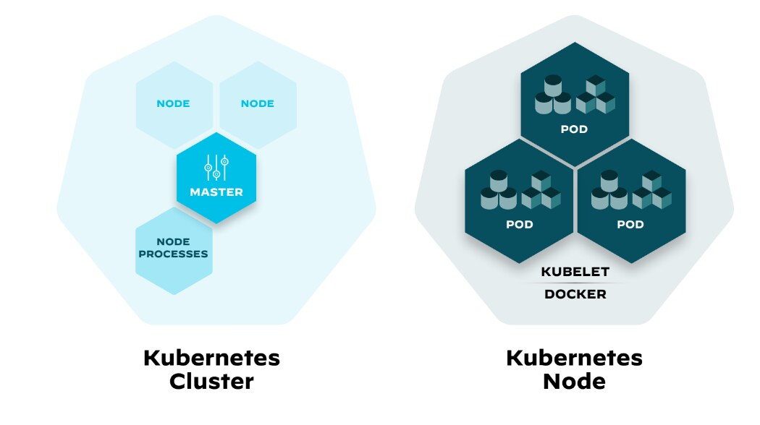
Notes:
https://www.paloaltonetworks.com/cyberpedia/what-is-kubernetes

Slide 9
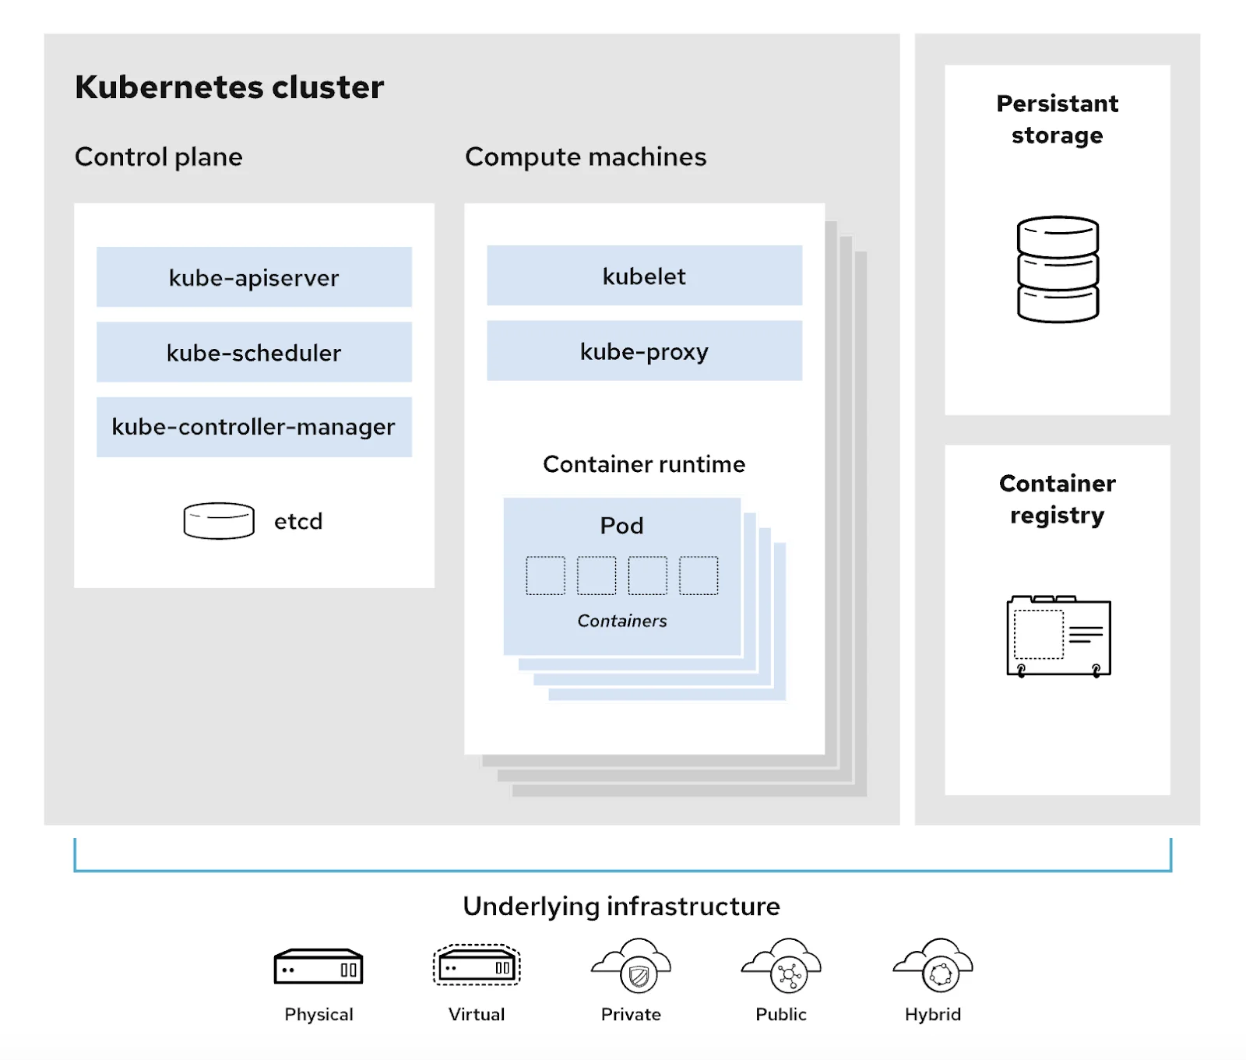
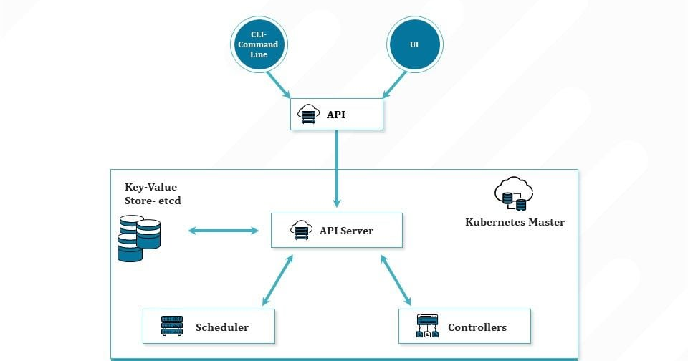
Components in a Kubernetes Architecture
Kubernetes infrastructure : Control plane or a Master node
Notes:
https://taikun.cloud/introducing-kubernetes-architecture-from-zero-to-deployment/
https://kubernetes.io/docs/concepts/overview/

Slide 10
Kubernetes :
Control Plane
kube-apiserver
The API server is the front end of the control plane
kube-scheduler
This component checks for the health of the cluster and identifies the resource needs of the system. The scheduler assigns new containers to the nodes
kube-controller-manager
A controller manager is the one that coordinates between all other components of the control plane.
etcd
etcd is a key-value store database that is responsible for storing the configuration data and information about the state of the cluster.
Compute machines/Worker node
Pods
Kubernetes is managing containers, it is actually managing pods which is the name for a bunch of containers.
Container runtime engine
The containers in each node is run by a container runtime engine in the respective node
kubelet
the component that communicates with the control plane and executes the instructions in the worker node.
kube-proxy
This component provides networking services to the node..

Slide 11
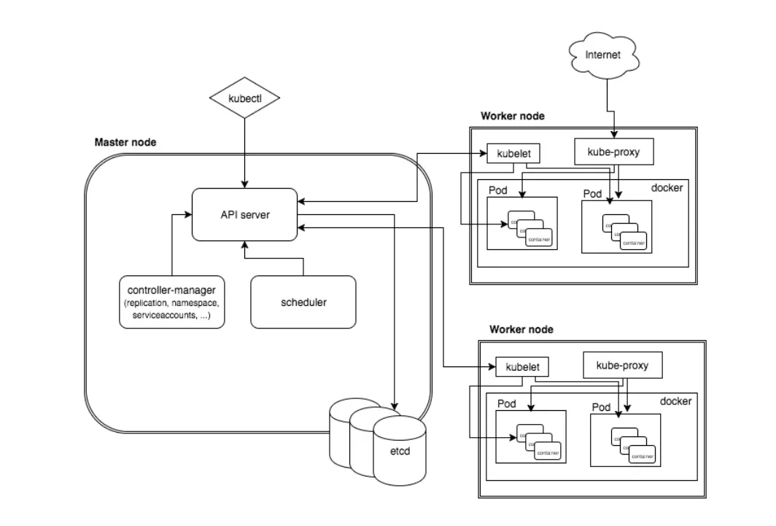

Slide 12
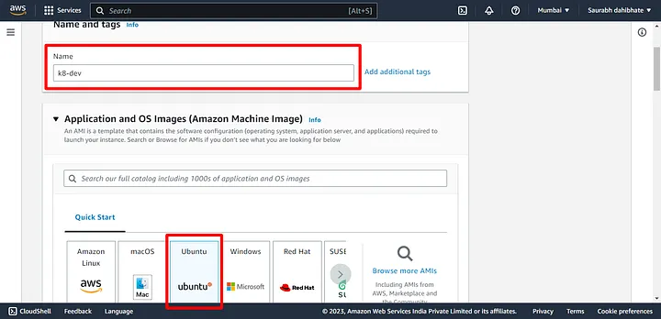
Minikube Installation and Creating First Pod
Minikube is compatible with different virtualization technologies such as VirtualBox, Hyper-V, and KVM.
What are the Features of Minikube?
Supports the latest Kubernetes release (+6 previous minor versions).
Cross-platform (Linux, macOS, Windows).
Deploy as a VM, a container, or on bare-metal.
Multiple container runtimes (CRI-O, containerd, docker).
Direct API endpoint for blazing fast image load and build.
Advanced features such as LoadBalancer, filesystem mounts, FeatureGates, and network policy.
Addons for easily installed Kubernetes applications.
Supports common CI environments.
Launch EC2 instance with “Ubuntu” Instance type as “t3.medium”.
https://www.atlantic.net/dedicated-server-hosting/how-to-deploy-kubernetes-cluster-with-minikube-on-ubuntu-20-04/
https://minikube.sigs.k8s.io/docs/tutorials/kubernetes_101/module2/
Notes:
https://aws.plainenglish.io/minikube-installation-and-creating-first-pod-6e4daee24d5f
https://minikube.sigs.k8s.io/docs/presentations/
https://kubernetes.io/blog/2019/03/29/kube-proxy-subtleties-debugging-an-intermittent-connection-reset/

Slide 13
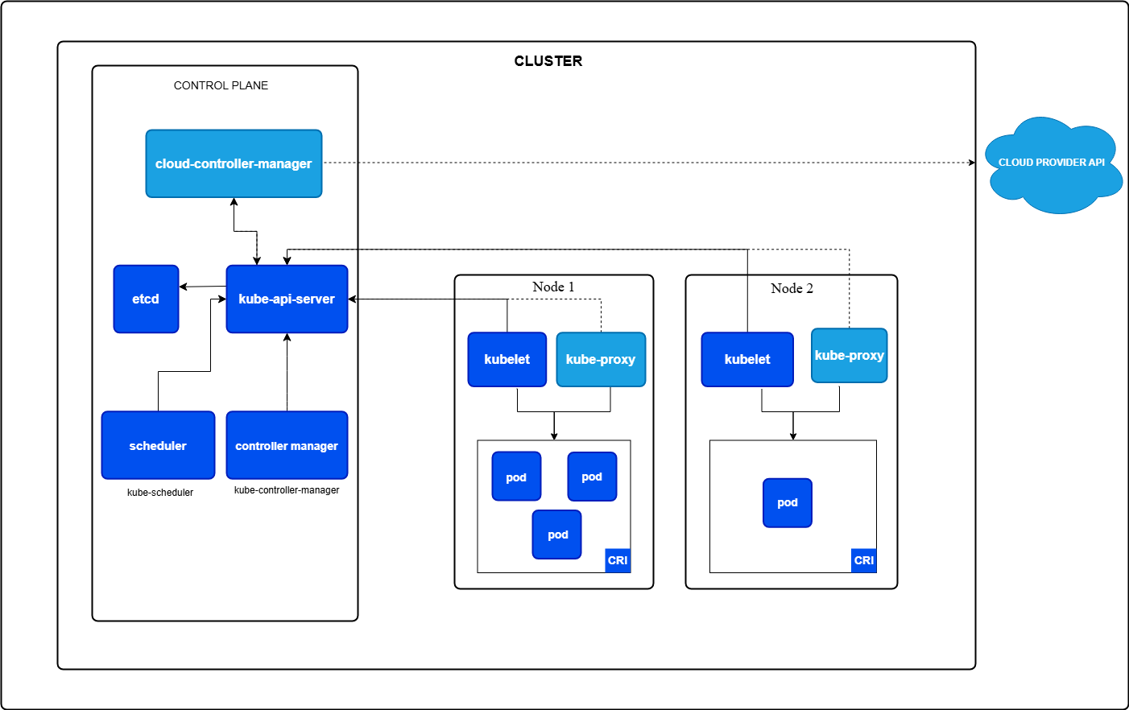
Cluster Architecture
Notes:
https://kubernetes.io/docs/concepts/architecture/

Slide 14
Kubernetes.io :
Node components
kubelet
the component that communicates with the control plane and executes the instructions in the worker node.
kube-proxy
This component provides networking services to the node
Container runtime
A fundamental component that empowers kubernetes to run containers effectively.
Pods
Kubernetes is managing containers, it is actually managing pods which is the name for a bunch of containers.
Container runtime engine
The containers in each node is run by a container runtime engine in the respective node
Control Plane Component
Control plane's components make global decisions about the cluster (for example, scheduling), as well as detecting and responding to cluster events (for example, starting up a new pod when a Deployment's replicas field is unsatisfied).
kube-apiserver
The API server is the front end of the control plane
kube-scheduler
This component checks for the health of the cluster and identifies the resource needs of the system. The scheduler assigns new containers to the nodes
kube-controller-manager
A controller manager is the one that coordinates between all other components of the control plane.
etcd
etcd is a key-value store database that is responsible for storing the configuration data and information about the state of the cluster.
Notes:
https://www.juniper.net/assets/us/en/local/pdf/nxtwork/cloud-containers-and-microservices-with-contrail.pdf

Slide 15
Thank You

Slide 16
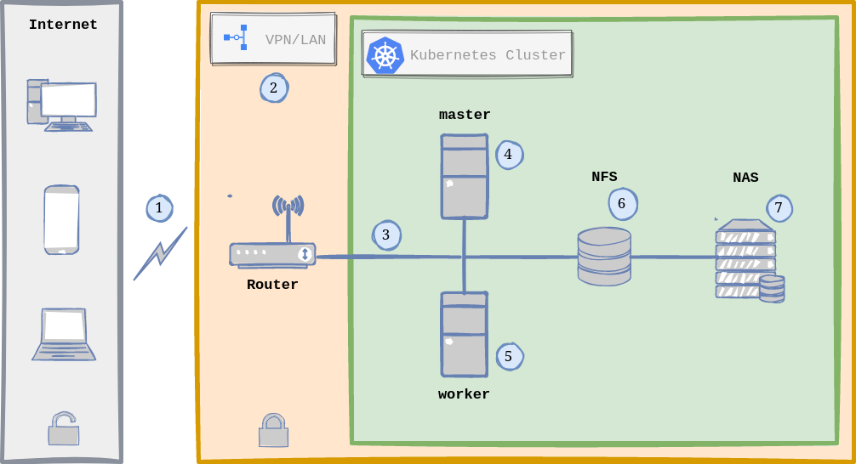
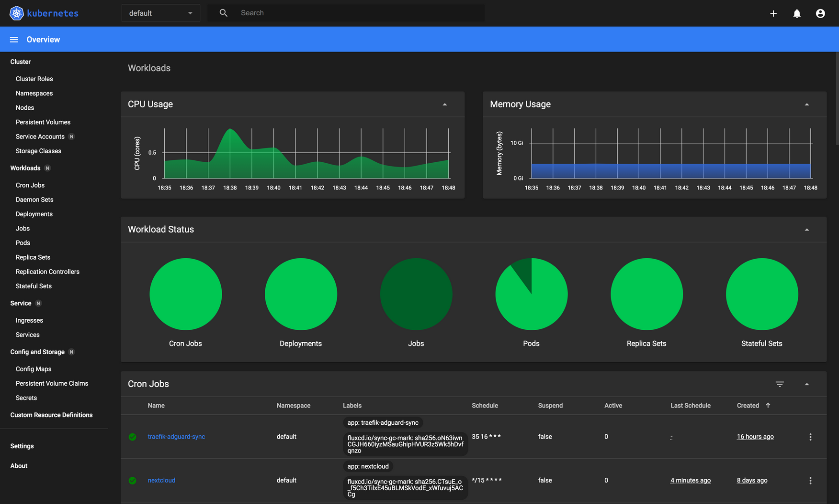
Ref
https://www.cherryservers.com/blog/install-kubernetes-ubuntu
https://fernandocejas.com/blog/engineering/2023-01-06-over-engineered-home-lab-docker-kubernetes/

